Slide 1
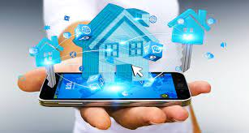
Smart Media System using Gesture
Controller
Made by:
Divij Bahl – 19BCE0789
Rishabh Keshan - 19BCE2366
Pratishtha Gaur -19BCE0104
Supervisor:
Prof. Arvind Kumar K

Slide 2
OUR PROJECT TEAM
Divij Bahl – 19BCE0789
Rishabh Keshan – 19BCE2366
Pratishtha Gaur - 19BCE0104

Slide 3
ABSTRACT
01

Slide 4
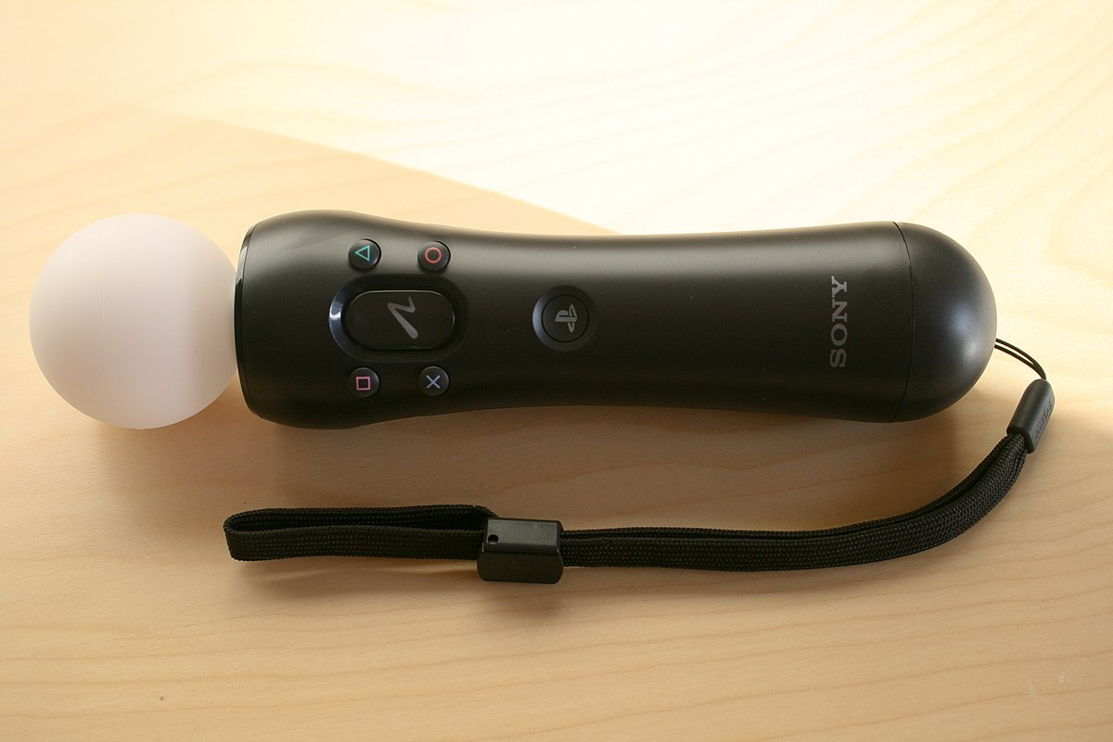
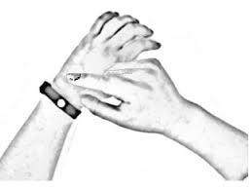
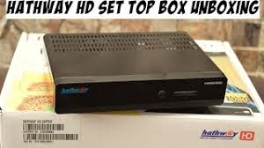
Abstract
Interacting through voice and hand gesture are some most convenient methods to interact.
Easy to learn for user since it is normal form of communication
Voice commands are already in use.
As many devices can be connected to this hand gesturing band
The device will be a handheld wireless sensor unit and a processing unit to detect gestures

Slide 5
NOVEL IDEA
02

Slide 6
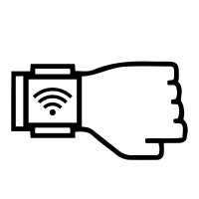
WHAT IS NEW?
Cheaper and Multi-Utility
External buttons providing a range of controls with upcoming bluetooth support.
Appropriate form factor for comfortable daily wear if worn as a device.
Existing Product designed for discrete gestures lack accuracy to be used in real scenarios.

Slide 7
Literature Survey
03

Slide 8
NO​ | TITLE​ | IMPLEMENTATION | CONCLUSION
01 | Gesture and speech interaction with a patient information system | Here they combined their gestural input technique with speech output and test whether or not the absence of a visual display impairs usability in this kind of multimodal interaction. This is of particular relevance to mobile, wearable and ubiquitous systems where visual displays may be restricted or unavailable. They conducted the evaluation using a prototype for a system combining gesture input and speech output to provide information to patients in a hospital Accident and Emergency Department. A group of participants was instructed to access various services using gestural inputs. | The gesture controlled device allows the user to perform multiple actions on a VCR video player, such as play, pause, volume control, channel control. According to research conducted, among the devices that could be controlled by gestures, home entertainment devices were the most popular. The device uses Hidden Markov Model to train the device to create user defined gestures. It does so by converting 3D data into 1D prototype vectors.
02 | An Arduino Based Gesture Control System for Human-Computer Interface | The proposed system uses Arduino microcontrollers, Ultrasonic distance sensors and Accelerometers for Human Computer Interaction. The distance sensor is mounted on a laptop or a computer. It records the gestures by measuring the distance between the sensor and the hand. The sensor data is sent to the Microcontroller which carries out further computation based on this data. Using Python Gesture Analysis and Recognition Library, the setup can perform file handling and keyboard shortcuts with predefined hotkeys. | The system has two interfaces, the distance sensor interface and the accelerometer interface. The distance sensor interface translates the gestures for actions such as shuffling between different applications, volume control, scrolling, keyboard shortcuts and so on; while the accelerometer interface realizes the typing part of the system.

Slide 9
NO​ | TITLE​ | IMPLEMENTATION | CONCLUSION
03 | Design and Implementation of Arduino-Based Gesture-Controlled System with Accelerometer | This paper presents the design of a robot which can take direct, real time instructions from a human operator through gesture control. It consists of the transmitter and the receiver parts and was programmed using Arduino. It was developed with Arduino-Mega, accelerometer and the robot-arm, which is controlled according to the signals it receives and are sent by the gestures of the hand. | A gesture controlled robotic arm was built using Arduino Mega 2560 and MPU 6050 accelerometer. The transmitter contains the accelerometer sensor and an RF module, while the receiver module contains RF receiver, Arduino board and a motor connected to the robotic arm. The receiver receives the serial information which is sent to the microcontroller which controls the motor and the arm. The microcontroller is programmed such that when there is a certain degree of tilt recorded by the sensor, it transmits signals to move the motor in the required direction.
04 | Gesture Controlled Robot using Arduino and Android | Gestures can be tracked using accelerometers. Since modern Smartphone are equipped with an in-built accelerometer, gesture control using Smartphone can be easy to implement, cheap to provide and the output will be more intuitive. This paper deals with the design and implementation of a wireless gesture controlled Robot using Arduino ATMEGA32 processor and an Android operated application to control the gestures via Bluetooth with minimal, and cheap hardware requirements. | Here, a movable robot was built using Android. The Android application detects hand gestures for moving forward, backwards, left or right and sends signals to the microcontroller in the robot via Bluetooth. The microcontroller controls 4 motors, for each wheel of the robot. It uses Adafruit motor shield library to allow Arduino to call predefined functions for rotation of the wheels.

Slide 10
NO​ | TITLE​ | IMPLEMENTATION | CONCLUSION
05 | Dynamic Hand Gesture Recognition Based on a Leap Motion Controller and Two-Layer Bidirectional Recurrent Neural Network | It uses the Leap Motion Controller which senses the palm direction and fingertip positions. The feature extraction uses LMC to detect the hand movements and output them. Then it uses Hidden Conditional Neural Field(HCNF) to classify the detected hand movements into a sample of the American Sign Language(ASL) dataset and other common gestures like poke, pinch, circle. | A new method is proposed to detect dynamic hand gestures. On the ASL dataset with 360 samples, the system achieves accuracies of 100% and 96.3% on the training and testing sets. On the ASL dataset with 480 samples, the system achieves accuracies of 100% and 95.2%. On the Handicraft-Gesture dataset, the system achieves accuracies of 100% and 96.7%

Slide 11
BLOCK DIAGRAM
04

Slide 12
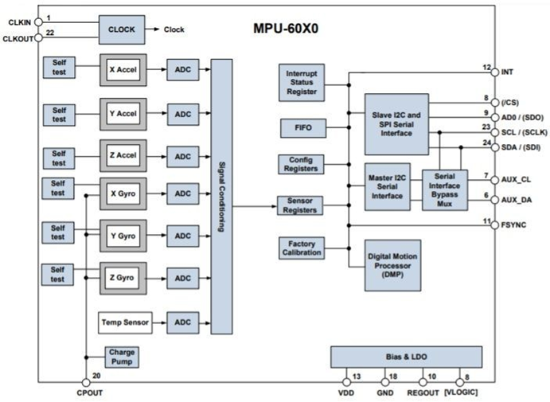
Block Diagram____

Slide 13
COMPONENTS
05

Slide 14
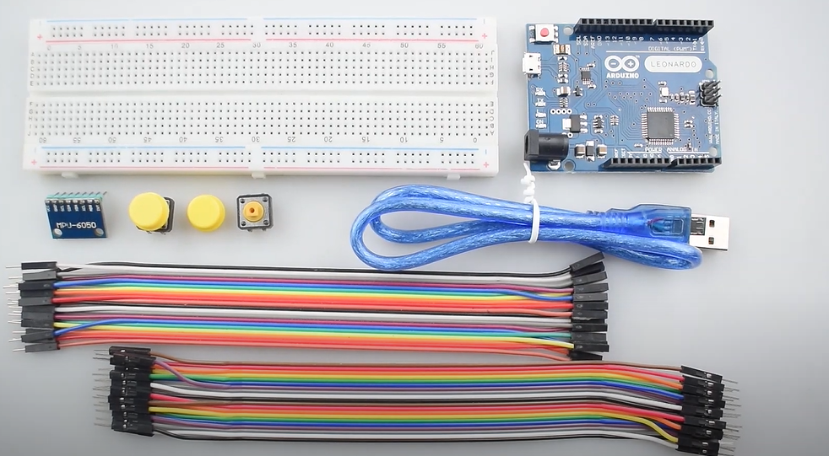
Hardware Components___
Arduino
MPU6050
MEMS gyroscope
Accelerometer
USB cable
Breadboard
Jumper wire
Push buttons
I2C digital communication interfaces.
Data registers for storing sensor data.
Programmable interrupts.
Temperature sensor.
Status register

Slide 15
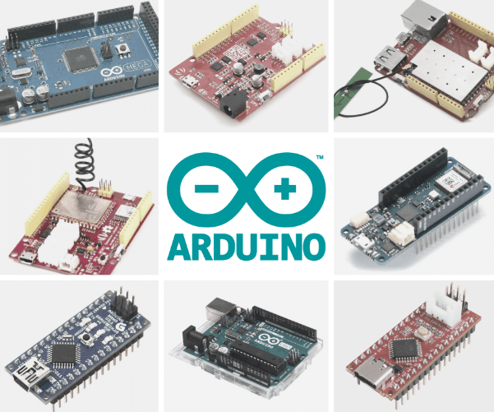

Software Components____
Objective C
Arduino software
Dependencies
Wire.h library
I2Cdev.h library
MPU6050.h library
Mouse.h library

Slide 16
FEATURES
06

Slide 17
Other Features ____
01
02
03
Digital motion sensor
Temperature Sensor
Gyroscope for direction sensing

Slide 18
METHODOLOGY
07

Slide 19
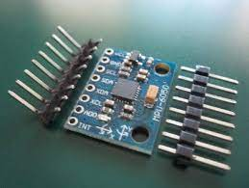
Methodology___
The MPU6050 reads the 3D coordinates of a hand placed over it (x,y,z) - which is read by Arduino Code.
Based on which threshold values the coordinates fall under, actions are classified.
This Action value is then read by the program is passed to the GUI setup for smart working.
We are focusing on smartboard features like drawing along, marking in images and a software simulation of a cube.

Slide 20
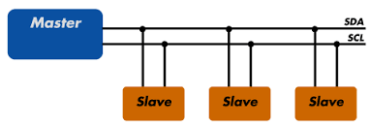
Methodology___
Communication protocol for detection unit will be I2C
For sending and receiving data between two or more devices we need a path which is called bus
It is a bidirectional two-wire bus which is used to send data between integrated circuits.

Slide 21
What is MPU6050?___
MPU6050 is a Micro Electro-mechanical system (MEMS),
It consists of three-axis accelerometer and three-axis gyroscope.
Measure velocity, orientation, acceleration, displacement and other motion like features.
Consists of Digital Motion Processor (DMP), which has property to solve complex calculations.
Consists of a 16-bit analog to digital converter hardware
Captures three-dimension motion at the same time.

Slide 22
Why MPU6050?___
3 kinds of accelerometer
ADXL 335/345- 3 axis accelerometers. It either uses I2C or SPI communication. It has inbuilt function of free fall detection and Inactivity detection.
MMA 7361- 3 axis accelerometer but this has a sleep mode and a select pin which can be helpful to save power. It works on the same principle as ADXL's
MPU 6050-3 axis accelerometer as well as a 3 axis gyroscope. It also has an onboard DMP(Digital Motion Processor) which is infact very tough and complex to use. The board has a 1024 byte FIFO buffer and uses I2C to communicate with the Arduino.
Notes:
. At the shorter distance of 0.5 m, the ADXL335 can detect all the three cases whilst the MPU6050 can detect all the cases at the distance of 0.5 m and also 1.5 m.

Slide 23
ABOUT ARDUINO
08

Slide 24
What is Arduino?___
Arduino is an open-source electronics platform based on easy-to-use hardware and software.
Arduino boards are able to read inputs like - light on a sensor, a finger on a button, or a Twitter message - and turn it into an output - activating a motor, turning on an LED, publishing something online.
This board can be interfaced with other Arduino boards, Arduino shields, Raspberry Pi boards and can control relays, LEDs, servos, and motors as an output.
Notes:
https://learn.sparkfun.com/tutorials/what-is-an-arduino/all

Slide 25
Why Arduino Leonardo for Gesture Recognition?
Leonardo is different from other Arduino boards because it has a microcontroller with inbuilt USB 2.0 communication.
The Leonardo board uses a single microcontroller to run your sketches as well as communicate with your PC using USB. This allows Leonardo far more flexibility in its communication with the computer.
The Leonardo is different from all preceding boards. The ATmega32u4 has built-in USB communication, which eliminates the need for a secondary processor. This allows the Leonardo to appear to any connected computer as a keyboard and mouse, in addition to a virtual COM port/ (CDC) serial.
It also has other implications for the behavior of the board.
Notes:
https://www.educba.com/arduino-leonardo-vs-uno/

Slide 26
PIN DIAGRAM
09

Slide 27
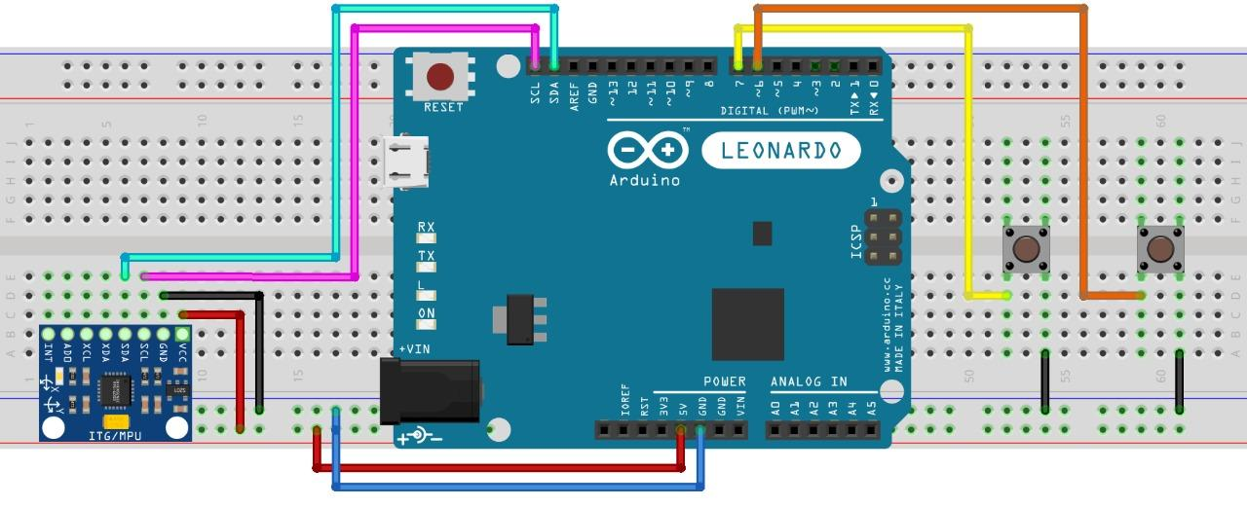
Pin Diagram____

Slide 28
FLOW CHART
10

Slide 29
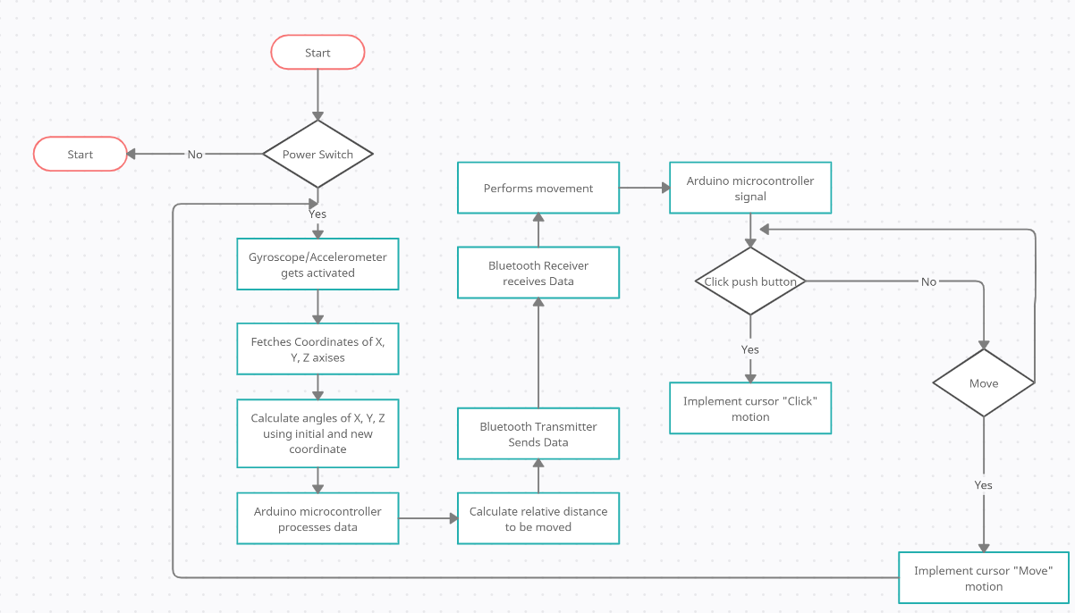
Flow Chart (Hardware)____

Slide 30
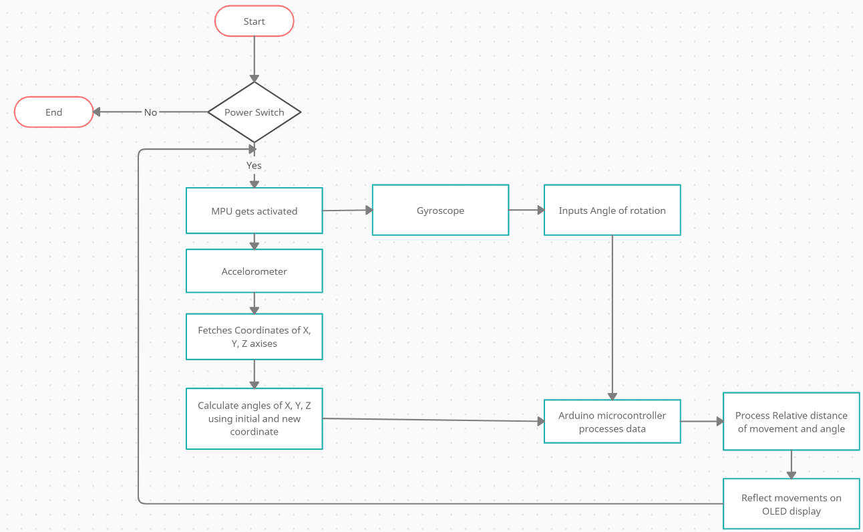
Flow Chart(Software)____

Slide 31
RESULT
11

Slide 32
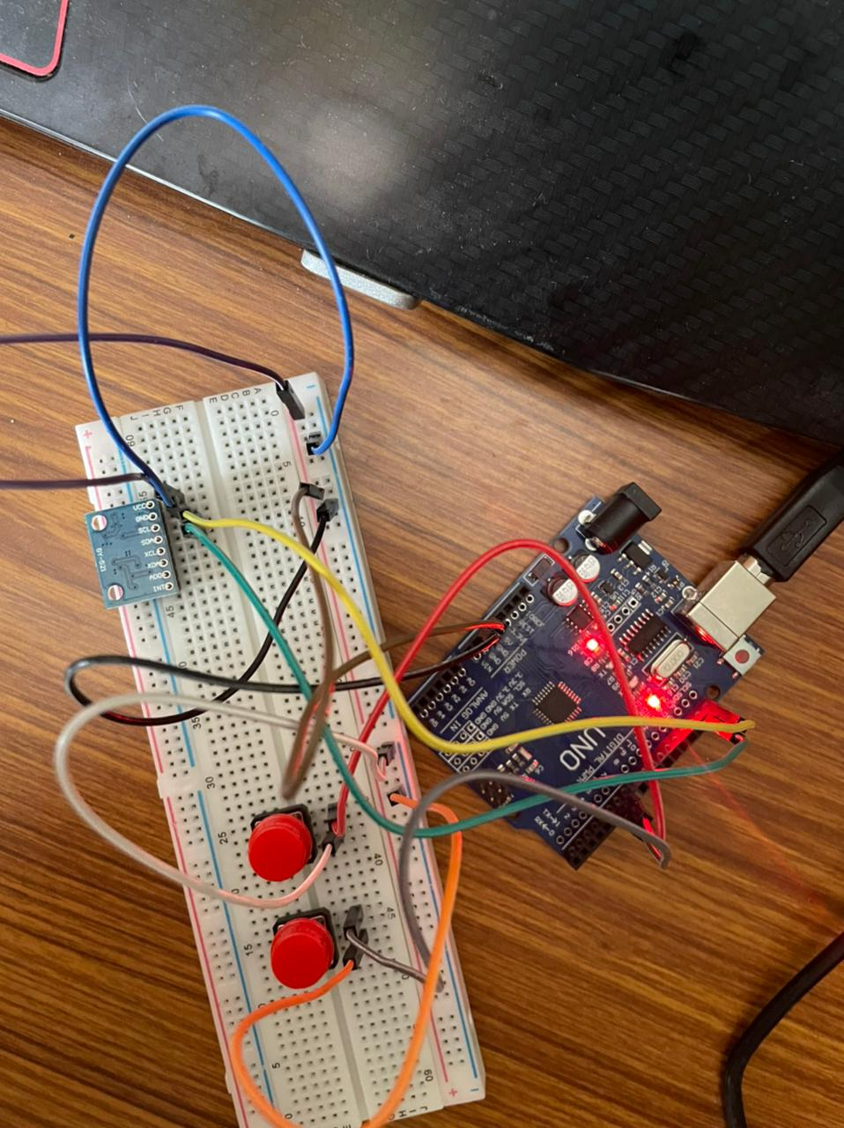
Hardware Implementation___

Slide 33
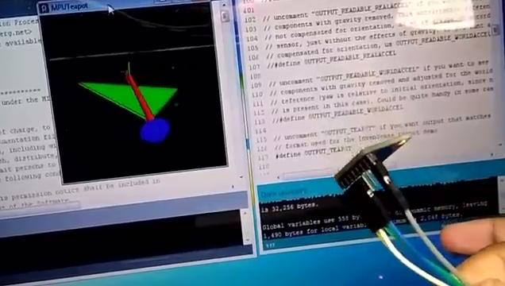
Hardware Implementation___

Slide 34
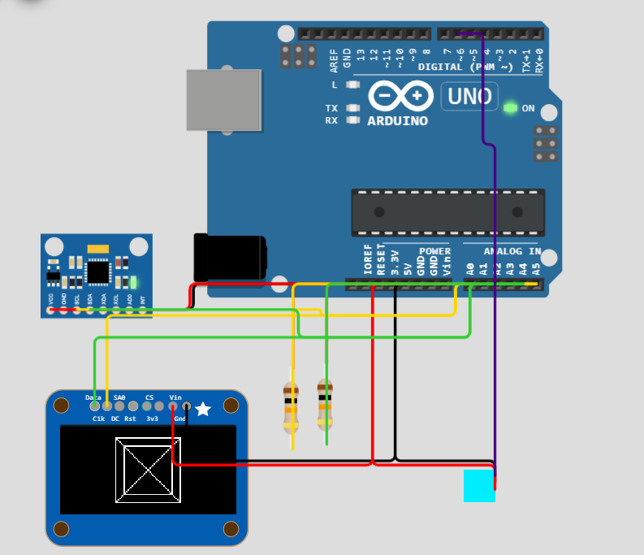
Simulation___

Slide 35
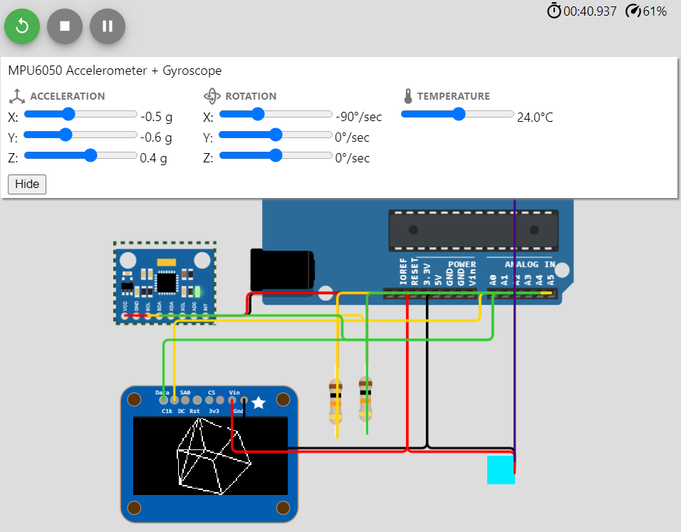
Simulation_____

Slide 36
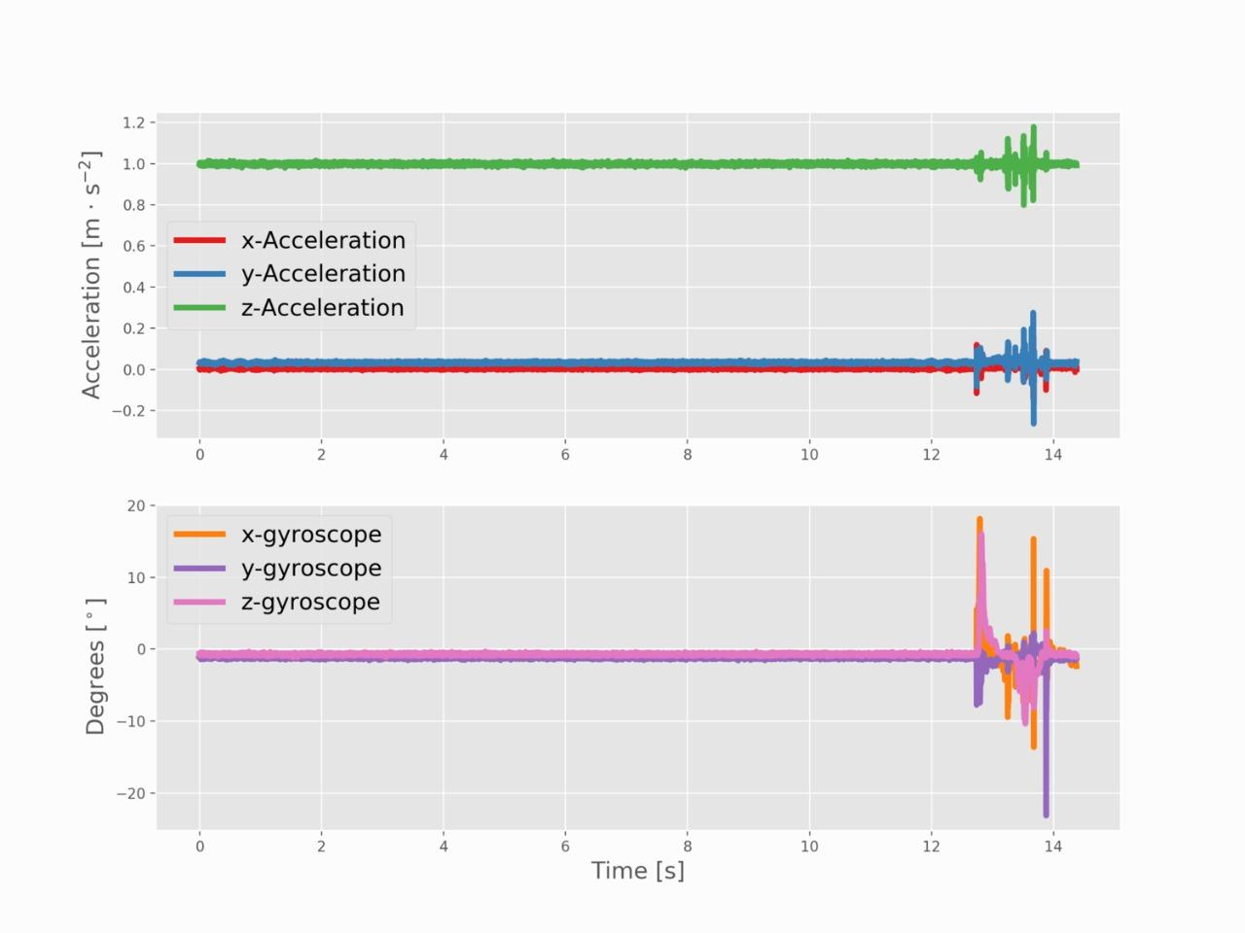
Graphs And Discussion

Slide 37
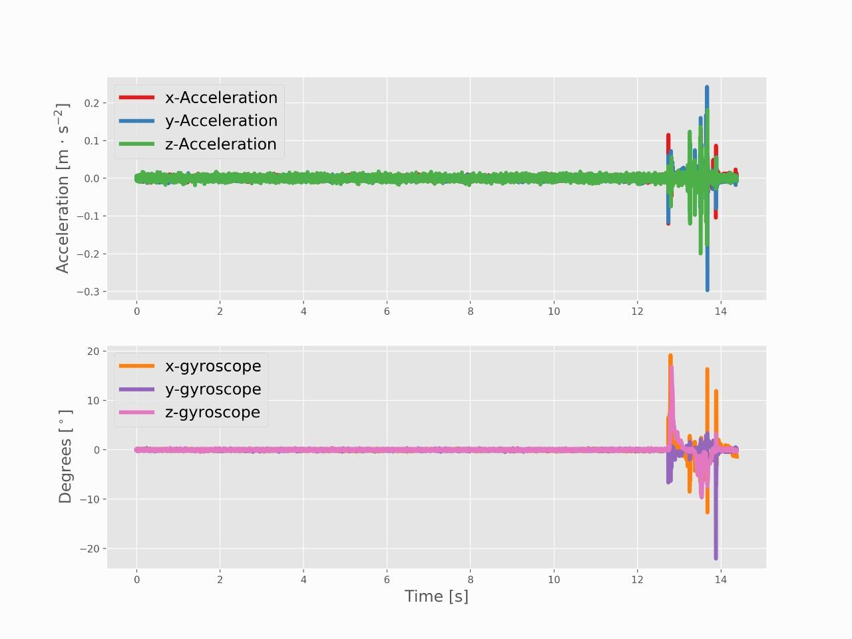
Graphs And Discussion

Slide 38
CODE SNIPPET
12

Slide 39
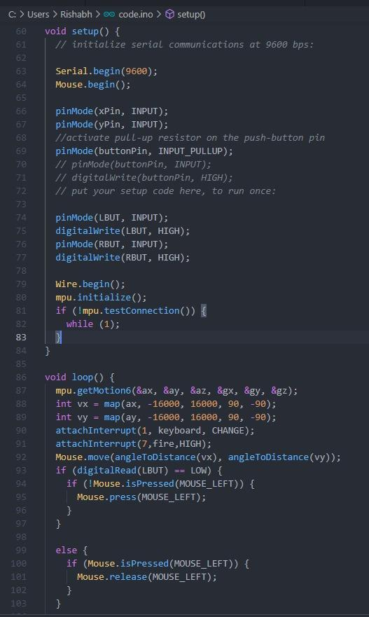
Code Snippet__

Slide 40
CONCLUSION
13

Slide 41
Conclusion___
Hence, we could utilize the efficiency and power of the Arduino and MPU 6050 for creating a prototype of a device very handy in today’s world. With additional and better hardware, we can have a more robust system with better gesture capabilities. We can also use this simple concept for more real-world projects.

Slide 42
FUTURE
14

Slide 43
Future Improvement_____
Scope of the same can be expanded.
Add more functions to code for other gestures
Can be expanded to work for every laptop or TVs
Eliminate light vibration and small movement of human body and consequently reduce the noise of data.
To implement more useful gestures by improving the algorithm of data processing.
Design more efficient power supply to reduce power loss.

Slide 44
REFERENCES
15

Slide 45
Reference Links___
Kela,J., Korpipää,P., Mäntyjärvi,J., Kallio,S., Savino,G., Jozzo,L.and Di Marca, S., 2006. Accelerometer-based gesture control for a design environment. Personal and Ubiquitous Computing, 10(5),pp.285-299.
Belgamwar, S. and Agrawal,S., 2018, August. An Arduino Based Gesture Control System for Human-Computer Interface. In 2018 Fourth International Conference on Computing Communication Control and Automation (ICCUBEA)(pp. 1-3).IEEE.
Nduanya, U.I., Oleka, C.V. and Orji, E.Z., DESIGN AND IMPLEMENTATION OF ARDUINO-BASED GESTURE-CONTROLLED SYSTEM WITH ACCELEROMETER.
Chanda,P., Mukherjee,P. and Subrata Modak,A., 2016. Gesture Controlled Robot using Arduino and Android.International Journal, 6(6).
Kebir,S.T.,Bouhedda,M.,Mekaoui,S.,Guesmi,M. and Douakh,A., 2016, November. Gesture control of mobile robot based arduino microcontroller. In 2016 8th International Conference on Modelling, Identification and Control (ICMIC)(pp. 1081-1085).IEEE.
Lu,W., Tong,Z. and Chu,J., 2016.Dynamic hand gesture recognition with leap motion controller.IEEE Signal Processing Letters,23(9), pp.1188-1192.
Yang,C., Jang,Y., Beh,J., Han,D. and Ko,H., 2012, January. Gesture recognition using depth-based hand tracking for contactless controller application. In 2012 IEEE International Conference on Consumer Electronics (ICCE) (pp.297-298).IEEE.

Slide 46
THANK YOU

